Slide 1


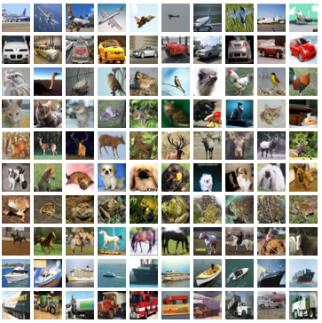
FINAL CAPSTONE PROJECT
CIFAR 10 Dataset
Image Recognition using Convolutional Neural networks
Presented by: Usman Shaikh

Slide 2

PROJECT DESCRIPTION AND PURPOSE
Description
Dataset: https://www.cs.toronto.edu/~kriz/cifar.html
CIFAR-10 is a subset of the 80 million tiny images dataset created by Canadian Institute for Advanced Research (CIFAR).
The CIFAR-10 dataset consists of 60000 32x32x3 color images in 10 equal classes, (6000 images per class).
Each class of images corresponds to a physical object (automobile, cat, dog, airplane, etc.)
In total there are 10 classes including airplane, automobile, bird, cat, deer, dog, frog, horse, ship and a truck.
Problem Summary
The purpose of this project is to develop a multi class classification model successfully predicting different classes.
Our goal is to train and test different machine learning models as per our requirement and then come up with one specific model which provides us with the best possible and consistent results in a timely fashion.
For this purpose we will be building eleven different machine learning models, two each for the Random Forest, Logistic Regression and Gradient Boost followed by 6 separate models of Convolutional Neural Networks.

Slide 3
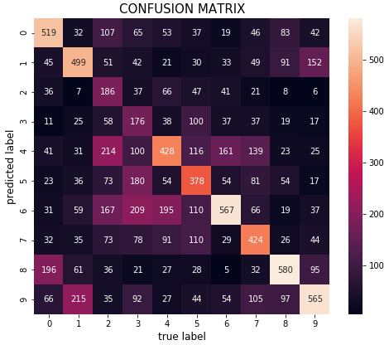
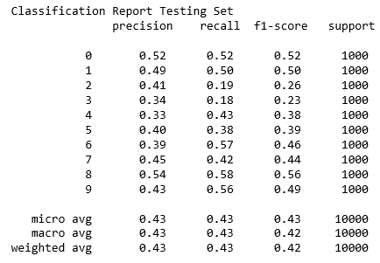
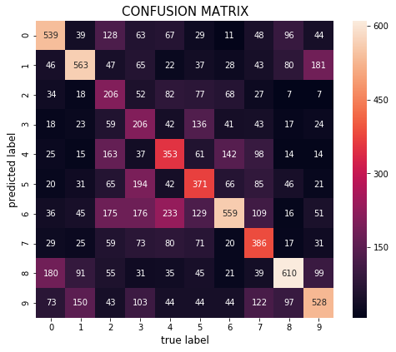
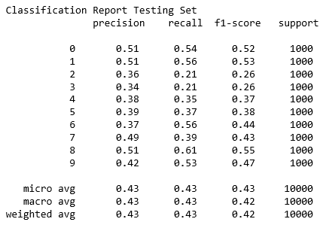
RANDOM FOREST
Without PCA
Variables: 3,072
Estimators: 500
Max depth: 10
R² Train Data: 0.64
R² Test Data: 0.43
Mean Absolute Error: 2.03
Mean Squared Error: 10.67
Root Mean Squared Error: 3.26
Time: 00:08:16.12
With PCA
Components = 56
Estimators: 500
Max depth: 10
R² Train Data: 0.60
R² Test Data: 0.43
Mean Absolute Error: 2.05
Mean Squared Error: 10.66
Root Mean Squared Error: 3.26
Time: 00:01:53.35

Slide 4
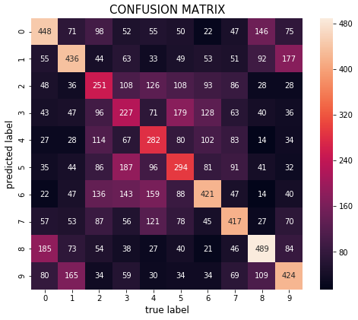
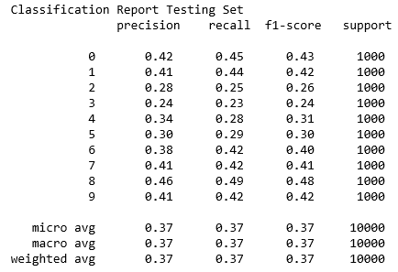
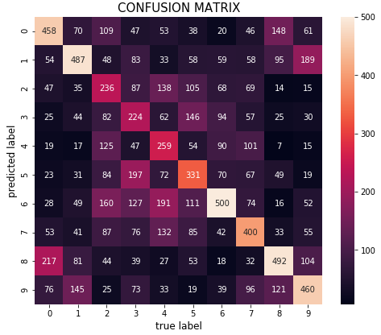
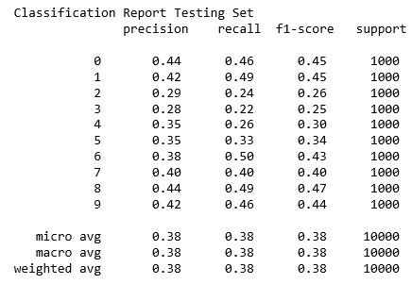
LOGISTIC REGRESSION
Without PCA
Variables: 3,072
R² Train Data: 0.52
R² Test Data: 0.36
Mean Absolute Error: 2.31
Mean Squared Error: 12.20
Root Mean Squared Error: 3.49
Time: 01:49:33.14
With PCA
Components = 56
R² Train Data: 0.3832
R² Test Data: 0.38
Mean Absolute Error: 2.25
Mean Squared Error: 11.86
Root Mean Squared Error: 3.44
Time: 00:00:16.38

Slide 5
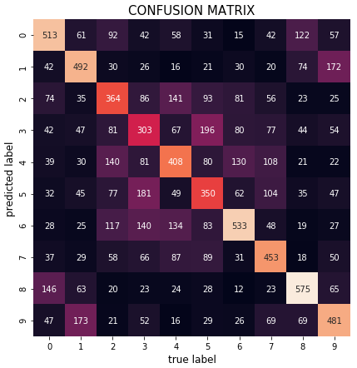

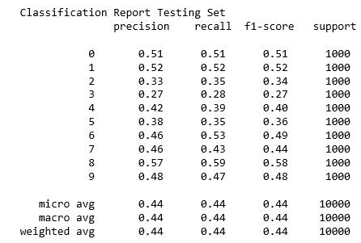
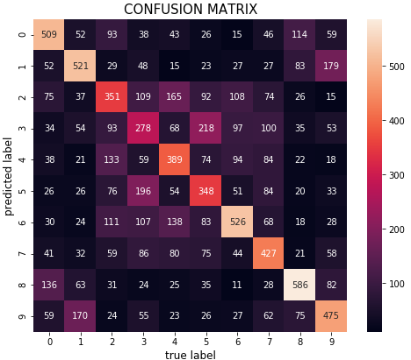
GRADIENT BOOST
Without PCA
Variables: 3,072
R² Train Data: 0.94
R² Test Data: 0.44
Mean Absolute Error: 1.98
Mean Squared Error: 10.21
Root Mean Squared Error: 3.19
Subsample = 0.3
Estimators = 50
Max depth =10
Time: 09:24:40.93
With PCA
Components = 56
R² Train Data: 0.92
R² Test Data: 0.44
Mean Absolute Error: 2.01
Mean Squared Error: 10.35
Root Mean Squared Error: 3.21
Subsample = 0.3
Estimators = 50
Max depth =10
Time: 00:14:35.99

Slide 6


MODEL COMPARISON
 | Random Forest | Logistic Regression | Gradient boost
Without PCA | R² Train Data: 0.64 R² Test Data: 0.43 | R² Train Data: 0.52 R² Test Data: 0.36 | R² Train Data: 0.94 R² Test Data: 0.44
Time | 00:08:16.12 | 01:49:33.14 | 09:24:40.93
With PCA | R² Train Data: 0.60 R² Test Data: 0.43 | R² Train Data: 0.38 R² Test Data: 0.38 | R² Train Data: 0.92 R² Test Data: 0.44
Time | 00:01:53.35 | 00:00:16.38 | 00:09:43.77
For comparison model parameters are kept same for both instances.
It shows that we are better off using Principle Component Analysis (PCA).
Processing times can be considerably reduced without compromising accuracy.
Models still require further tuning and fail to produce desired results.

Slide 7
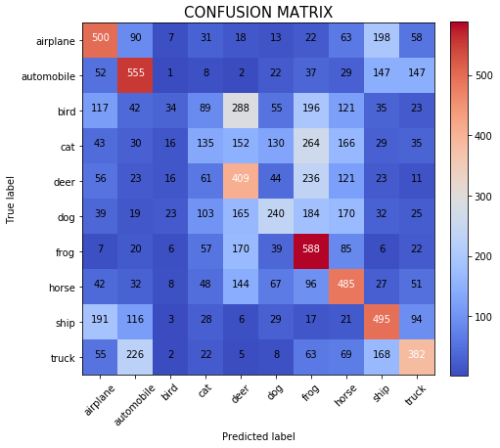
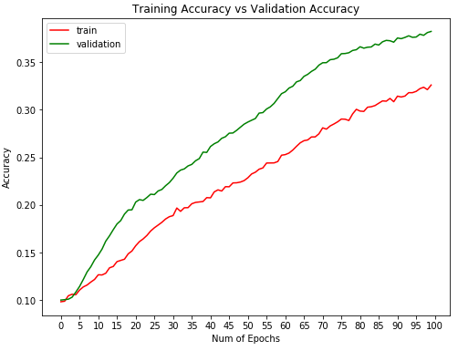
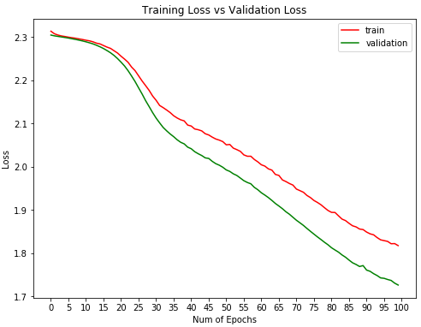
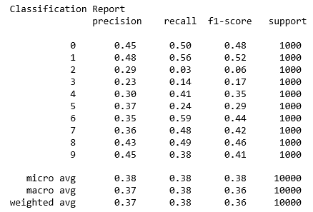
CONVOLUTIONAL NEURAL NETWORKS – MODEL 1
MODEL 1 (4 Layers)
Name: model1
Variables: 3,072
Convolutional layers: 4
Max pooling layers: 2
Dense Layers: 2
Dropout layers: 3 (0.25 – 0.5)
Activation Functions used
Rectified Linear Unit (RELU)
Soft max
Optimizer: SGD
Loss = sparse categorical cross entropy
Learning rate = 0.0001
Batch size = 32
Epochs = 100
Total time: 02:29:19.31
Test loss: 1.72
Test accuracy: 0.38

Slide 8
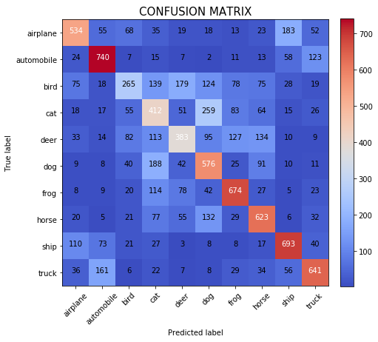
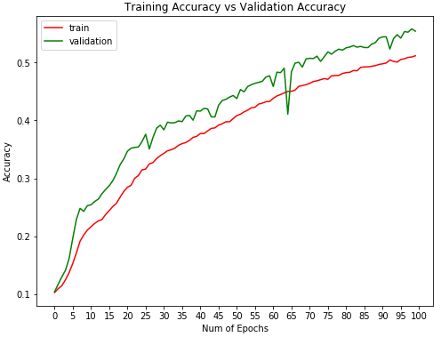
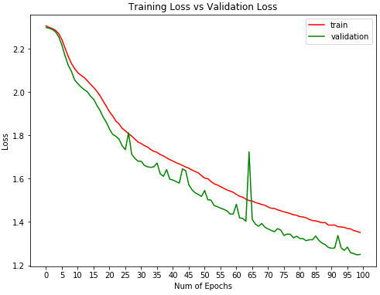
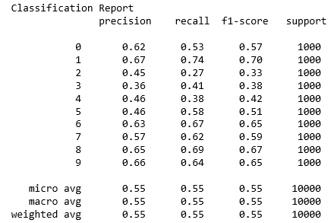
CONVOLUTIONAL NEURAL NETWORKS – MODEL 2
MODEL 2 (4 Layers)
Name: model1b
Variables: 3,072
Convolutional layers: 4
Max pooling layers: 2
Dense Layers: 2
Dropout layers: 3 (0.25 – 0.5)
Activation Functions used
Rectified Linear Unit (RELU)
Soft max
Optimizer: SGD
Loss = sparse categorical cross entropy
Learning rate = 0.001 +
Batch size = 64 +
Epochs = 100
Total time: 02:18:07.45
Test loss: 1.25
Test accuracy: 0.55

Slide 9
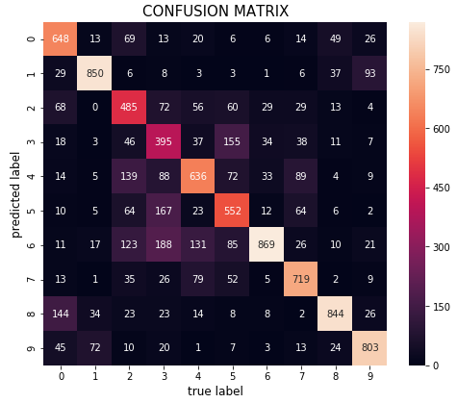
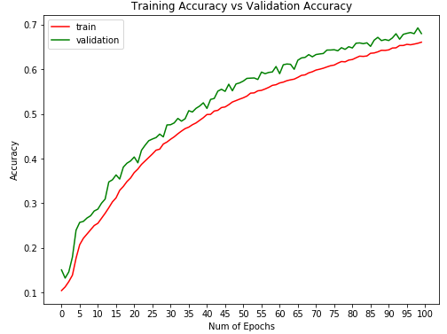
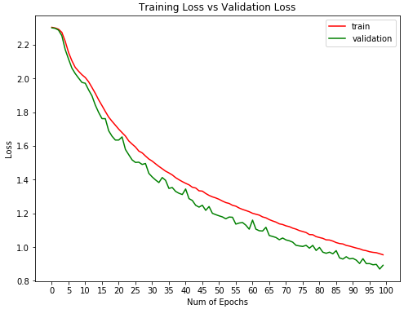
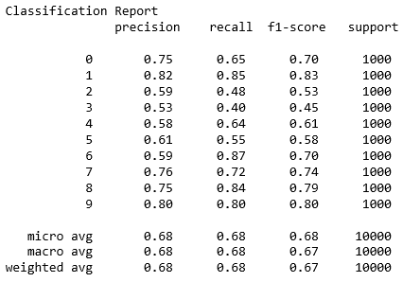
CONVOLUTIONAL NEURAL NETWORKS – MODEL 3
MODEL 3 (6 Layers)
Name: model2b
Variables: 3,072
Convolutional layers: 6 +
Max pooling layers: 3 +
Dense Layers: 2
Dropout layers: 4 (0.25 – 0.5) +
Activation Functions used
Rectified Linear Unit (RELU)
Soft max
Optimizer: SGD
Loss = sparse categorical cross entropy
Learning rate = 0.001
Batch size = 32
Epochs = 100 +
Total time: 04:27:32.18
Test loss: 0.89
Test accuracy: 0.68

Slide 10
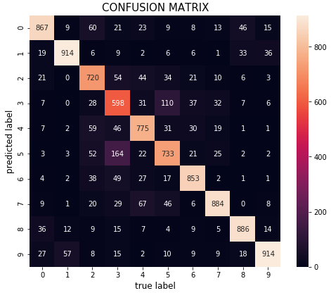
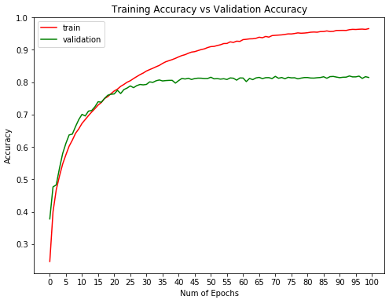
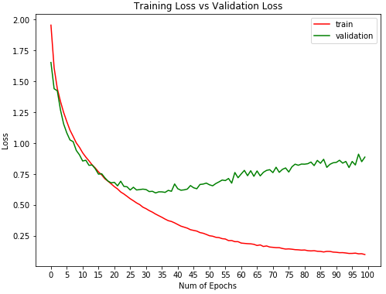
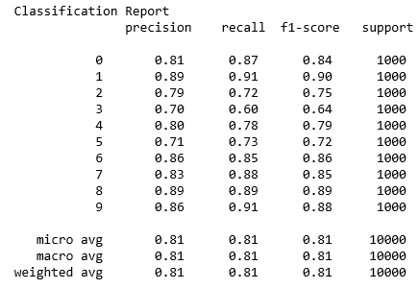
CONVOLUTIONAL NEURAL NETWORKS – MODEL 4
MODEL 4 (8 Layers)
Name: model3
Variables: 3,072
Convolutional layers: 8 +
Max pooling layers: 4
Dense Layers: 2
Dropout layers: 5 (0.25 – 0.5) +
Activation Functions used
Rectified Linear Unit (RELU)
Soft max
Optimizer: SGD
Loss = sparse categorical cross entropy
Learning rate = 0.0001 -
Batch size = 64 +
Epochs = 100
Total time: 05:28:11.04
Test loss: 0.886
Test accuracy: 0.814

Slide 11
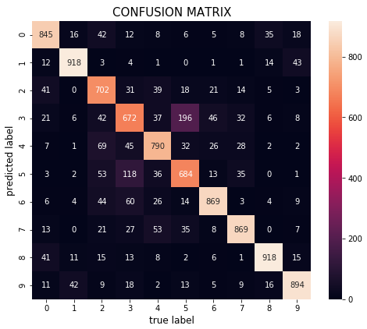
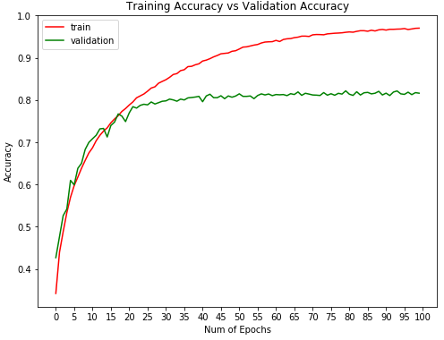
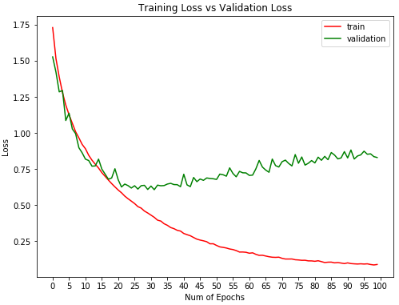
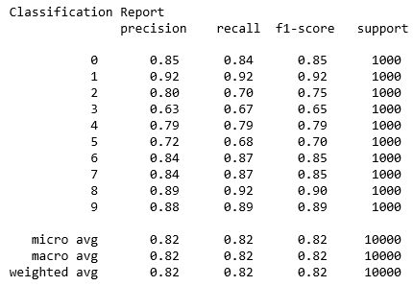
CONVOLUTIONAL NEURAL NETWORKS – MODEL 5
MODEL 5 (10 Layers)
Name: model4
Variables: 3,072
Convolutional layers: 10 +
Max pooling layers: 4
Dense Layers: 2
Dropout layers: 5 (0.25 – 0.5) +
Activation Functions used
Rectified Linear Unit (RELU)
Soft max
Optimizer: SGD
Loss = sparse categorical cross entropy
Learning rate = 0.0001
Batch size = 64
Epochs = 100
Total time: 10:30:20.44
Test loss: 0.830
Test accuracy: 0.816

Slide 12
MODEL COMPARISON
Traditional Models
 | Random Forest | Logistic Regression | Gradient boost
Without PCA | R² Train Data: 0.64 R² Test Data: 0.43 | R² Train Data: 0.52 R² Test Data: 0.36 | R² Train Data: 0.94 R² Test Data: 0.44
Time | 00:08:16.12 | 01:49:33.14 | 09:24:40.93
With PCA | R² Train Data: 0.60 R² Test Data: 0.43 | R² Train Data: 0.38 R² Test Data: 0.38 | R² Train Data: 0.92 R² Test Data: 0.44
Time | 00:01:53.35 | 00:00:16.38 | 00:09:43.77
Convolutional Neural Networks
 | Model1 | Model1b | Model2b | Model3 | Model4
Loss | 1.72 | 1.25 | 0.89 | 0.886 | 0.830
Accuracy | 0.38 | 0.55 | 0.68 | 0.814 | 0.816
Time | 02:29:19.31 | 02:18:07.45 | 00:09:43.77 | 05:28:11.04 | 10:30:20.44

Slide 13
CONCLUSION
Using Principle Component Analysis (PCA) was found effective for reducing dimensionality. It appeared to provide more time efficient results without compromising accuracy. In some instances results that were achieved using regular modeling techniques and which took extra long time to process were obtained in fraction of the time using PCA.
Nevertheless traditional learning models such as Random Forest, Logistic Regression and Gradient boosting were time efficient however were unable to provide a higher accuracy in order for the model to be successful.
For Convolutional Neural Networks adding more layers put heavy penalties on processing times. However at the same time CNN models displayed consistent results showing gradual fall in loss and increase in accuracy.
In conclusion the models that serve the purpose well for image recognition include Convolutional Neural Networks and Random Forest. CNN although can be time consuming, however it offers far better accuracy than any other traditional machine learning models. Random Forest performed fairly well among traditional models however does not match up in delivering performance as that of Convolutional Neural Networks.
For this project CNN (Model3) provides best possible results with 81% accuracy and a processing time of 5 hours and 30 minutes. This is followed by another CNN (Model4) which takes in additional layers and provides same level of accuracy within twice the amount of time taken by Model3 which is 10 hours 30 minutes.

